Slide 1
Homelessness Study
Evelyn McCarty

Slide 2
Goals
Model homelessness using market-based predictions to try and outperform the Housing & Urban Development report (linked in Github)
Explore ridge & lasso based regression models & multi-variable prediction models

Slide 3
Limitations
DesignMatrix vs standard DataFrames limited the scope of our additional step
Far hazier results due to the study being sociological rather than a controlled experiment

Slide 4
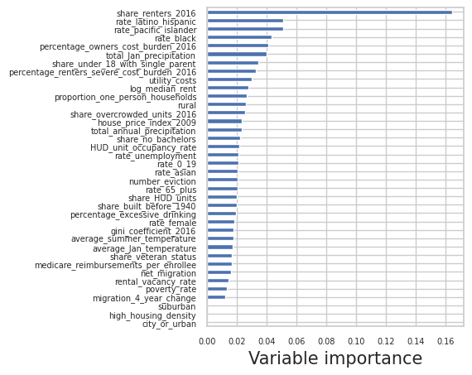
Variable importance

Slide 5
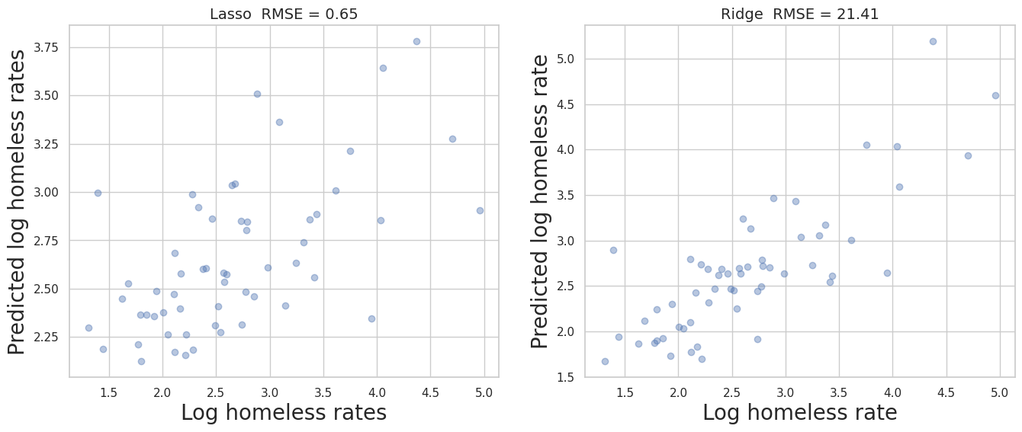
Ridge & lasso regression: Additional step model

Slide 6
Studying subsets of the data
(warning: unreliable)

Slide 7
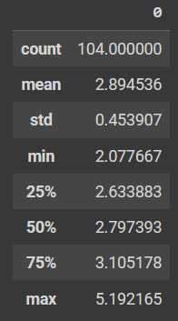
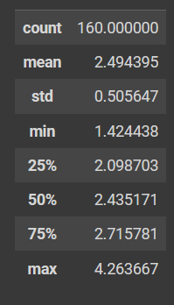
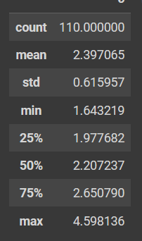
City
Suburb
Rural

Slide 8
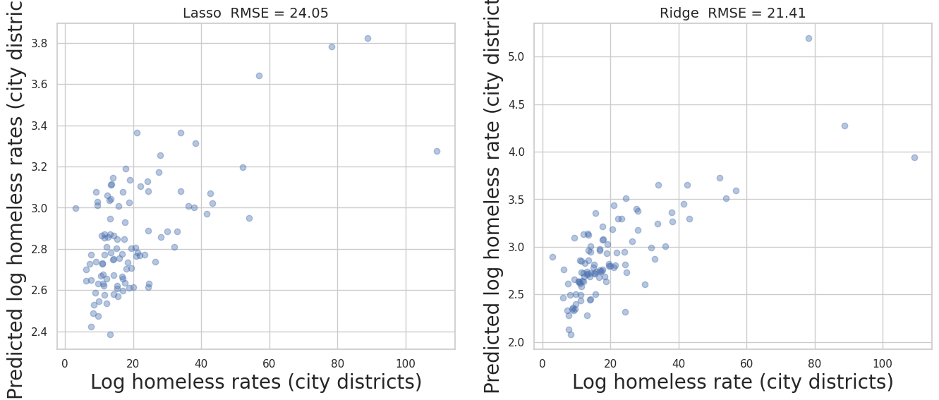
City data

Slide 9
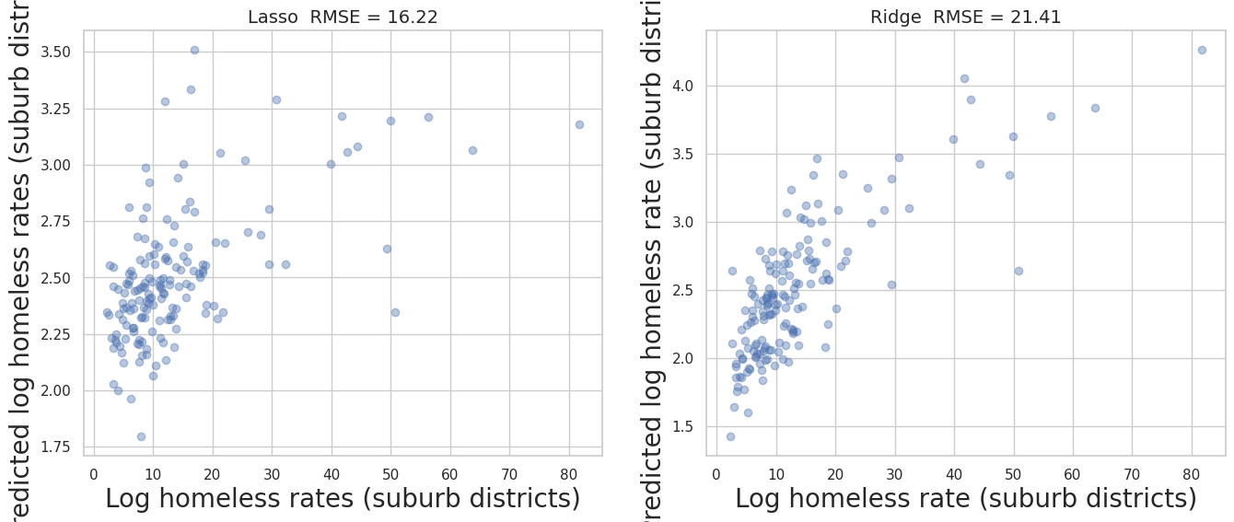
Suburb data

Slide 10
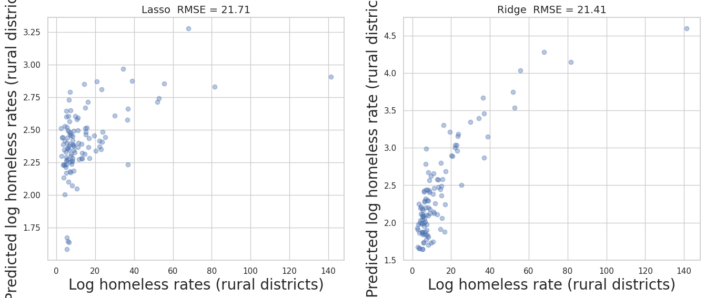
Rural data

